Slide 1


Rachel Lawale
6th Aug, 2024

Slide 2

Outline
Executive Summary
Introduction
Methodology
Results
Conclusion
Appendix

Slide 3
Executive Summary
Methodology:
Data Collection: APIs, web scraping, databases
Data Wrangling: Cleaned, transformed data
Exploration: Descriptive stats, visualizations
SQL: Queried, combined data
Statistical Analysis: Correlation, regression
Grouping: Categorical analysis
Modeling: Built and evaluated predictive models
Results:
Data Quality: High-quality, consistent dataset
Insights: Key patterns, relationships identified
SQL Queries: Efficient data extraction
Visualizations: Clear variable relationships
Models: Accurate predictions with high performance

Slide 4
Introduction
Problem Background and Context
The commercial space age is making space travel affordable. Companies like Virgin Galactic, Rocket Lab, Blue Origin, and SpaceX are leading the charge. SpaceX stands out due to its cost-effective reusable Falcon 9 rockets, significantly reducing launch costs. Falcon 9 launches cost $62 million vs. competitors' $165 million, primarily due to reusable first stages.
Objective
The objective is to determine the price of each launch
Key Challenge
Predict if SpaceX's Falcon 9 first stage will land successfully, impacting launch cost
Approach
Utilize data collection, analysis, and machine learning models to forecast the likelihood of first stage reuse.

Slide 5

Section 1

Slide 6
Methodology
Executive Summary
Data collection methodology:
Rocket launch data was requested from SpaceX API with the URL. API was used to extract information using identification numbers in the launch data
BeautifulSoup was used scrape HTML tables and the data was converted to Pandas DataFrame.
Perform data wrangling
Data Wrangling was done to normalize data into flat table and additional API endpoints was used
Perform exploratory data analysis (EDA) using visualization and SQL
Perform interactive visual analytics using Folium and Plotly Dash
Perform predictive analysis using classification models
How to build, tune, evaluate classification models

Slide 7
Data Collection
Rocket launch data was requested from SpaceX API with the URL
API was used to extract information using identification numbers in the launch data
To make the requested JSON results more consistent, json_normalize was used.
BeautifulSoup was used scrape HTML tables and the data was converted to Pandas DataFrame.
Data Wrangling was done to normalize data into flat table and additional API endpoints was used
Null values was handled by calculating the mean
One-hot encode was used for landing pad with null values

Slide 8
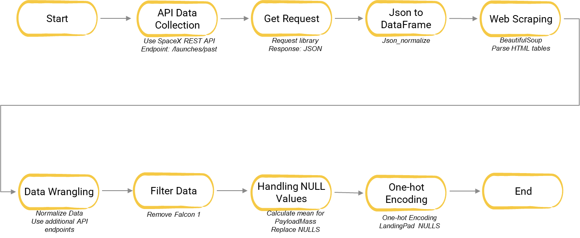
Data Collection – SpaceX API
Data Collection Process
API Setup:
Define the Base URL: api.spacexdata.com/v4/.
Identify the Endpoint: /launches/past.
Make API Request:
Use the requests library to perform a GET request.
Retrieve JSON response from the API.
Parse JSON Response:
Use the .json() method to convert the response to a JSON object.
Normalize JSON data into a flat table using json_normalize.
Extract Specific Data:
Use additional endpoints to gather detailed information (e.g., /rockets, /launchpads).
Merge data from multiple endpoints.
Data Cleaning:
Filter data to remove unnecessary entries (e.g., exclude Falcon 1 launches).
Handle NULL values by imputing or removing them
Data Collection FlowChart
https://github.com/lawalerachel/Applied-Data-Science-Capstone/blob/main/data-collection-api.ipynb

Slide 9
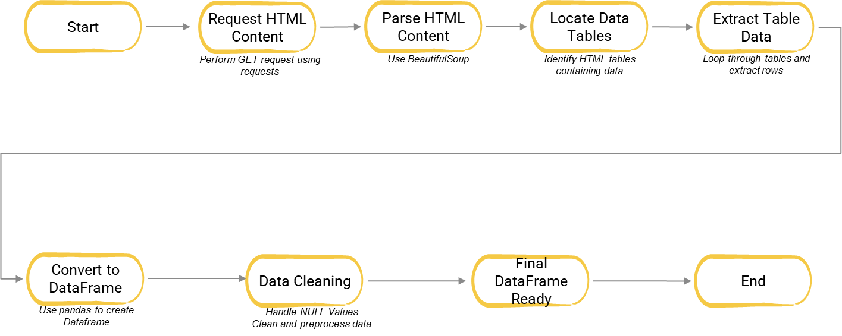
Data Collection - Scraping
Web Scraping Setup:
Import necessary libraries:
requests, BeautifulSoup, pandas.
Define target URL for scraping
Request and Parse HTML
Perform GET request to the URL.
Parse HTML content using BeautifulSoup.
Extract Data:
Locate HTML tables containing data.
Extract data from HTML tables.
Data Wrangling:
Convert extracted data to Pandas DataFrame.
Clean and preprocess data (e.g., handle NULL values).
Data Scraping FlowChart
https://github.com/lawalerachel/Applied-Data-Science-Capstone/blob/main/Data%20Collection%20-%20web%20scraping.ipynb

Slide 10
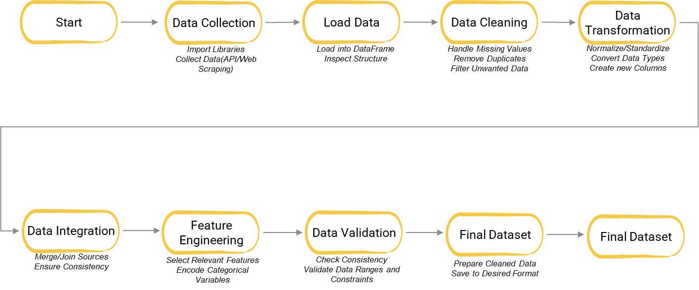
Data Wrangling
Data Wrangling Process:
Data Collection:
Data was collected using the SpaceX REST API and web scraping from relevant web pages.
The JSON responses from the API were converted into Pandas DataFrames.
Attribute Extraction:
Key attributes extracted include: Flight Number, Date, Booster version, Payload mass, Orbit, Launch Site, Outcome, Flights, Grid Fins, Reused, Legs, Landing pad, Block, Reused count, Serial, Longitude, and Latitude.
Attribute Cleaning:
The LaunchSite column was cleaned to categorize different launch sites such as Vandenberg AFB, Kennedy Space Center, and CCAFS SLC 40.
The Orbit column was standardized to include orbits like LEO (Low Earth Orbit) and GTO (Geosynchronous Transfer Orbit).
Outcome Processing:
The Outcome column, indicating if the first stage successfully landed, was converted into binary classes:
1 for successful landings (e.g., True ASDS).
0 for unsuccessful landings (e.g., False ASDS).
The classification variable Y was created to represent these outcomes.
Data Normalization:
The data was normalized and structured into a flat table, ensuring consistency and ease of analysis.
Data Wrangling FlowChart
https://github.com/lawalerachel/Applied-Data-Science-Capstone/blob/main/Data%20wrangling.ipynb

Slide 11
EDA with Data Visualization
Each of these charts was chosen to provide specific insights into the data, helping to identify patterns, relationships, and trends related to flight numbers, launch sites, payload mass, orbit types, and mission outcomes. These visualizations are essential for making data-driven decisions and understanding the performance of space missions.
Flight Number vs. Launch Site (Categorical Plot):
Chart Type: Scatter plot using catplot with FlightNumber on the x-axis, LaunchSite on the y-axis, and class as the hue.
Purpose: This chart was used to visualize the distribution of flight numbers across different launch sites and to distinguish successful (class=1) and failed (class=0) missions. It helps in understanding if certain launch sites have a higher success rate or are associated with more frequent launches.
Payload Mass vs. Launch Site (Scatter Plot):
Chart Type: Scatter plot with PayloadMass on the x-axis, LaunchSite on the y-axis, and class as the hue.
Purpose: This chart was plotted to observe any relationship between the payload mass and the launch sites, and to see how successful (class=1) and failed (class=0) missions are distributed with respect to payload mass across different launch sites.
Success Rate by Orbit Type (Bar Chart):
Chart Type: Bar chart showing the mean success rate (average of the class column) grouped by Orbit.
Purpose: This chart was created to analyze the success rate of missions for each orbit type, helping to identify which orbits have higher or lower success rates. This can provide insights into the difficulty or reliability of missions targeting different orbits.
Flight Number vs. Orbit Type (Scatter Plot):
Chart Type: Scatter plot with FlightNumber on the x-axis, Orbit on the y-axis, and class as the hue.
Purpose: This plot was used to visualize the relationship between flight numbers and orbit types. It helps in understanding how missions targeting different orbits are distributed over time and their respective success rates.
https://github.com/lawalerachel/Applied-Data-Science-Capstone/blob/main/Exploring%20and%20Preparing%20Data.ipynb

Slide 12
EDA with SQL
Summary of SQL Queries Performed
Names of the unique launch sites in the space mission was displayed using: SELECT DISTINCT Launch_Site FROM SPACEXTABLE;
5 records where launch sites begin with the string 'CCA’ was displayed using: SELECT * FROM SPACEXTABLE WHERE Launch_Site LIKE 'CCA%' LIMIT 5;
The total payload mass carried by boosters launched by NASA (CRS) was displayed using: SELECT SUM(PayloadMass) FROM SPACEXTABLE WHERE Booster_Version LIKE 'NASA (CRS)%’;
The average payload mass carried by booster version F9 v1.1. was displayed using: SELECT AVG(PayloadMass) FROM SPACEXTABLE WHERE Booster_Version = 'F9 v1.1’;
The date when the first successful landing outcome in ground pad was achieved using: SELECT MIN(Date) FROM SPACEXTABLE WHERE Landing_Outcome = 'Success' AND Landing_Pad = 'Ground pad’;
The names of the boosters which have success in drone ship and have payload mass greater than 4000 but less than 6000.was displayed using: SELECT Booster_Version FROM SPACEXTABLE WHERE Landing_Outcome = 'Success (drone ship)' AND PayloadMass BETWEEN 4000 AND 6000;
The total number of successful and failure mission outcomes was displayed using: SELECT Outcome, COUNT(*) AS Count FROM SPACEXTABLE GROUP BY Outcome;
The names of the booster_versions which have carried the maximum payload mass was listed using: SELECT Booster_Version FROM SPACEXTABLE WHERE PayloadMass = (SELECT MAX(PayloadMass) FROM SPACEXTABLE);
https://github.com/lawalerachel/Applied-Data-Science-Capstone/blob/main/EDA-sql-coursera_sqllite.ipynb

Slide 13
Build an Interactive Map with Folium
Markers:
Launch Site Markers: Placed at the geographical coordinates of each SpaceX launch site. These markers indicate the location of the launch sites and often include popup information with details about the site.
Launch Outcome Markers: Used to mark the success or failure of each launch at the respective sites. Different colors or icons are used to distinguish between successful and failed launches.
Circles:
Proximity Circles: Placed around each launch site to visualize a defined radius (e.g., 10 km) around the site. These circles help in understanding the geographical proximity of the launch sites to nearby features such as cities, water bodies, or other significant landmarks.
Lines:
Distance Lines: Drawn from each launch site to nearby proximities or points of interest. These lines represent the distance between the launch site and other relevant locations, helping to analyze the spatial relationships and potential influences on launch outcomes.
By creating and adding these map objects to a Folium map, we can interactively explore and analyze the geographical patterns and proximities of SpaceX launch sites, potentially uncovering factors that influence launch success rates.
https://github.com/lawalerachel/Applied-Data-Science-Capstone/blob/main/Analysis%20with%20Folium.ipynb

Slide 14
Build a Dashboard with Plotly Dash
A Plotly Dash application was built for users to perform interactive visual analytics on SpaceX launch data in real-time. This dashboard application contains input components such as a dropdown list and a range slider to interact with a pie chart and a scatter point chart. We have four different launch sites and we would like to first see which one has the largest success count. Then, we would like to select one specific site and check its detailed success rate (class=0 vs. class=1). As such, we will need a dropdown menu to let us select different launch sites.
A callback function was added to render success-pie-chart based on selected site dropdown. The general idea of this callback function is to get the selected launch site from site-dropdown and render a pie chart visualizing launch success counts.
https://rachellawale-8050.theianext-1-labs-prod-misc-tools-us-east-0.proxy.cognitiveclass.ai/

Slide 15
Predictive Analysis (Classification)
Summary of Model Development Process
Data Preparation
Load Data: Import the dataset containing relevant features and labels.
Preprocess Data:
Train-Test Split
Split Data: Divide the dataset into training and testing subsets to evaluate model performance on unseen data.
Model Training: Fit various classification models using the training data.
Logistic Regression
Support Vector Machines (SVM)
Decision Tree Classifier
K-Nearest Neighbors (KNN)
Model Evaluation
Accuracy: Measure the proportion of correctly classified instances.
Confusion Matrix: Analyze true positives, true negatives, false positives, and false negatives to assess performance.
Classification Report: Review precision, recall, and F1-score for a detailed performance assessment.
Hyperparameter Tuning
Define Hyperparameters: Set ranges of hyperparameters for each model.
Grid Search: Use Grid Search to find the optimal hyperparameters that enhance model performance.
select Best Model: Identify the model with the best performance metrics based on hyperparameter tuning results.
Final Evaluation
Re-evaluate Best Model: Test the selected model with the best hyperparameters on the test set.
Output Results: Present final performance metrics, including accuracy, confusion matrix, and classification report.

Slide 16
Results
Exploratory data analysis results
Interactive analytics demo in screenshots
Predictive analysis results

Slide 17

Section 2

Slide 18
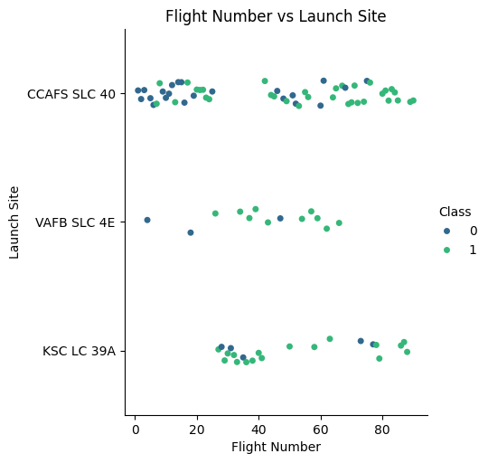
Flight Number vs. Launch Site

Slide 19
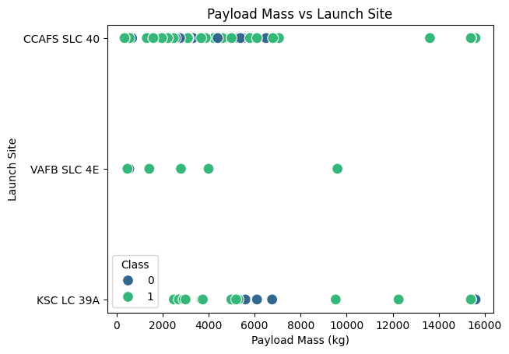
Payload vs. Launch Site

Slide 20
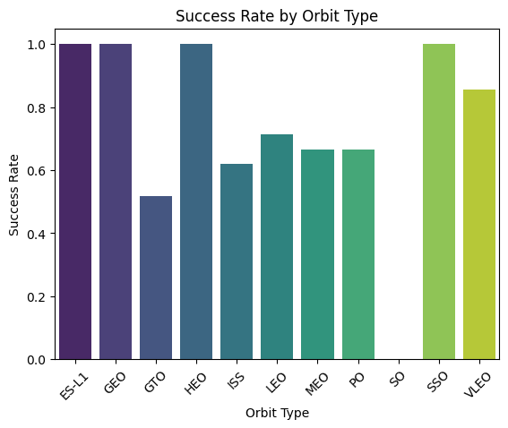
Success Rate vs. Orbit Type

Slide 21
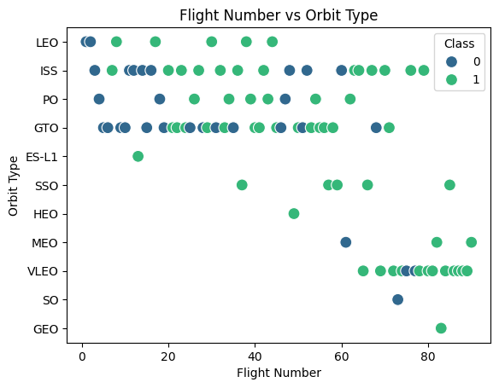
Flight Number vs. Orbit Type

Slide 22
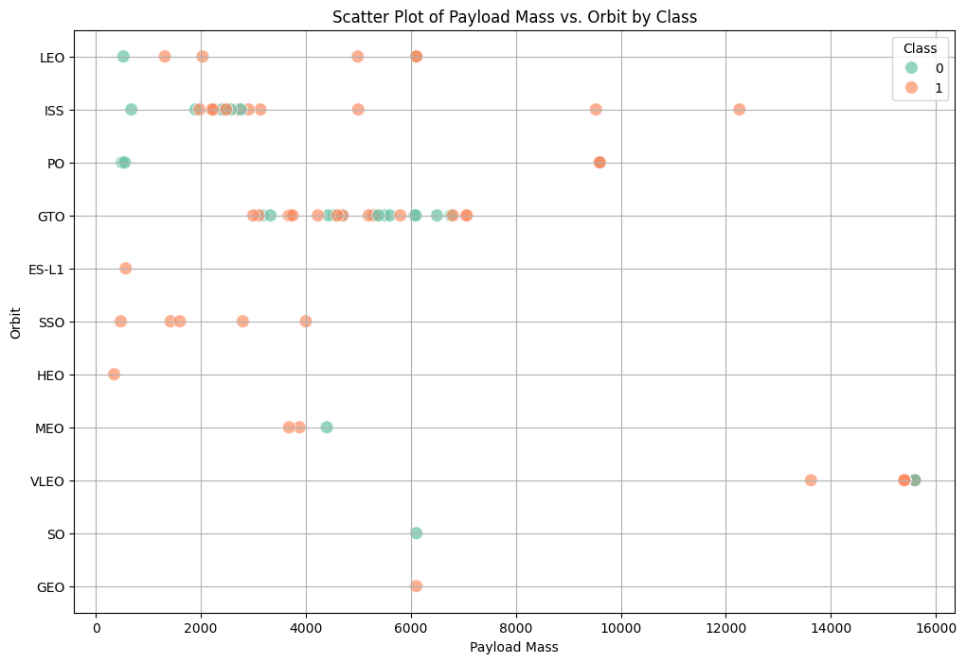
Payload vs. Orbit Type

Slide 23
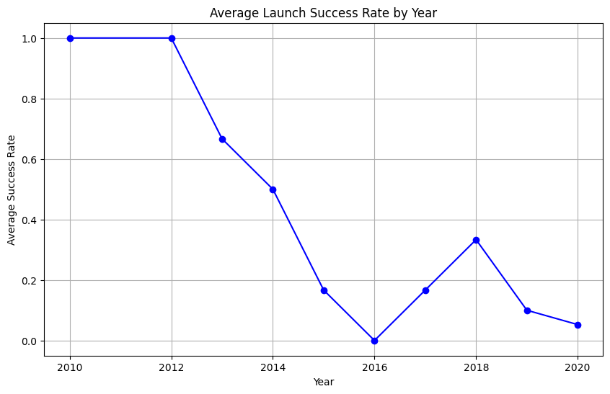
Launch Success Yearly Trend

Slide 24
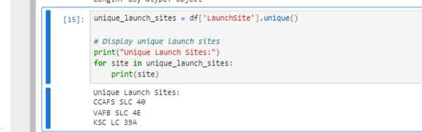
All Launch Site Names
The DataFrame data contains a column LaunchSite with the names of different launch sites.
The unique() function is used to extract unique values from the LaunchSite column.
The unique launch site names are printed out.
The provided sample data, the unique launch sites are:CCAFS SLC 40VAFB SLC 4E.
This result shows the distinct launch sites from the dataset, indicating that the launches occurred at these sites. If you have a larger dataset or additional questions, let me know!

Slide 25
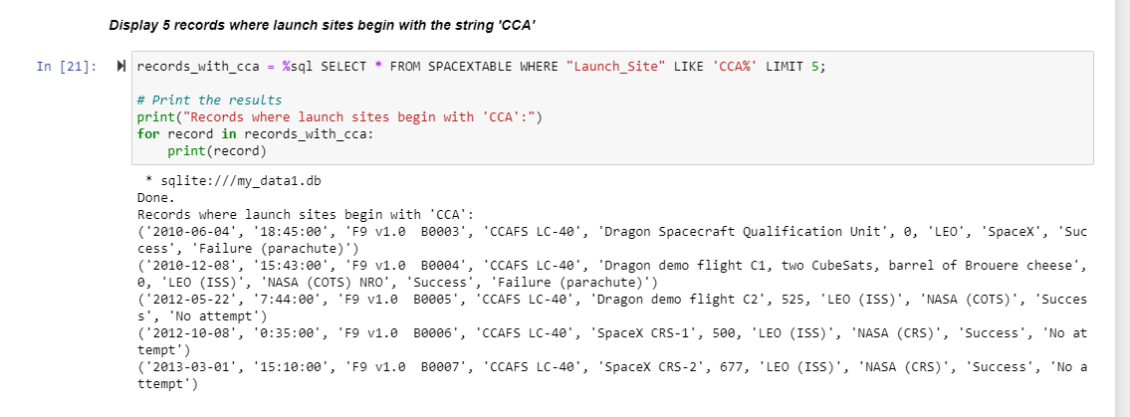
Launch Site Names Begin with 'CCA'
SQL Query Components:
SELECT *: Selects all columns from the table.
FROM SPACEXTABLE: Specifies the table from which to retrieve the data.
WHERE "Launch_Site" LIKE 'CCA%': Filters the rows to include only those where the Launch_Site column starts with CCA.
LIMIT 5: Limits the results to the first 5 matching records.
records_with_cca = %sql SELECT * FROM SPACEXTABLE WHERE "Launch_Site" LIKE 'CCA%' LIMIT 5; # Print the results print("Records where launch sites begin with 'CCA':") for record in records_with_cca: print(record)
The displayed records include flight numbers, dates, launch sites, and other relevant information where the Launch_Site begins with CCA.
All the records show CCAFS SLC 40 as the launch site, which matches the specified condition.

Slide 26
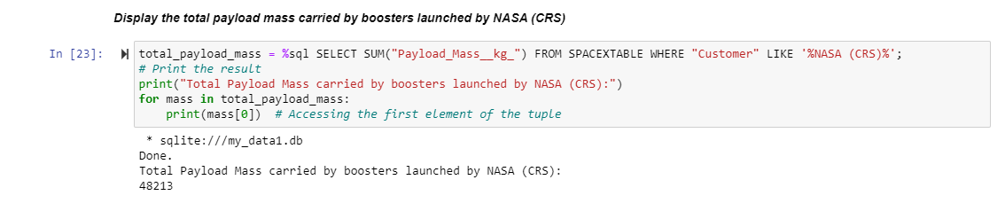
Total Payload Mass
Code Explanation
Total_payload_mass = %sql SELECT SUM("Payload_Mass__kg_") FROM SPACEXTABLE WHERE "Customer" LIKE '%NASA (CRS)%’;
# Print the result print("Total Payload Mass carried by boosters launched by NASA (CRS):") for mass in total_payload_mass: print(mass[0]) # Accessing the first element of the tuple
total_payload_mass = %sql SELECT SUM("Payload_Mass__kg)
print("Total Payload Mass carried by boosters launched by NASA (CRS):"): Prints a descriptive message.
for mass in total_payload_mass:: Iterates over the result, which is a list of tuples.
print(mass[0]): Accesses and prints the first (and only) element of the tuple, which contains the total payload mass.
Total Payload Mass: The result 48213 represents the total payload mass, in kilograms, carried by boosters launched for the customer NASA (CRS).
Interpretation: This number indicates that the combined payload mass of all the relevant launches amounts to 48,213 kg.
This query provides a summary of the total payload mass specifically for NASA’s CRS missions, which can be useful for understanding the scale of payloads handled for this customer.

Slide 27
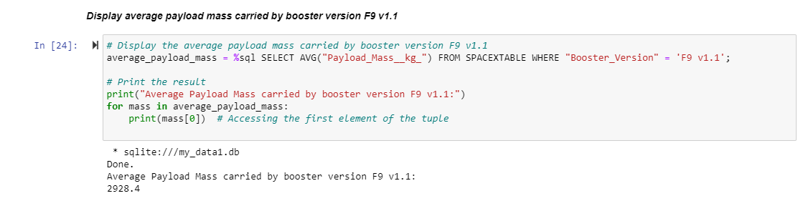
Average Payload Mass by F9 v1.1
Code Explanation
average_payload_mass = %sql SELECT AVG("Payload_Mass__kg_") FROM SPACEXTABLE WHERE "Booster_Version" = 'F9 v1.1’;
# Print the result print("Average Payload Mass carried by booster version F9 v1.1:") for mass in average_payload_mass: print(mass[0]) # Accessing the first element of the tuple
average_payload_mass = %sql SELECT AVG("Payload_Mass__kg_") ...: Executes the SQL query and stores the result in average_payload_mass. This result is typically a list of tuples.
print("Average Payload Mass carried by booster version F9 v1.1:"): Prints a descriptive message.
for mass in average_payload_mass:: Iterates over the result, which is a list of tuples.
print(mass[0]): Accesses and prints the first (and only) element of the tuple, which contains the average payload mass.
Average Payload Mass: The result 2928.4 represents the average payload mass in kilograms carried by the booster version F9 v1.1.
Interpretation: This means that, on average, each launch with the F9 v1.1 booster version carried a payload mass of 2,928.4 kg.
This query helps in understanding the payload capacity performance of the F9 v1.1 booster version by providing the average mass of payloads it has carried.

Slide 28
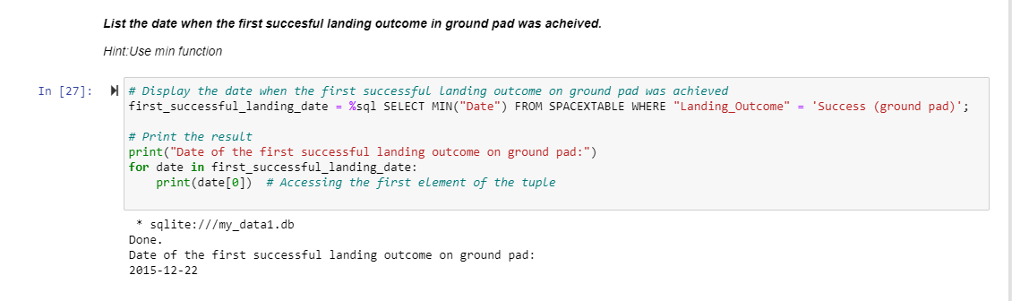
Find the dates of the first successful landing outcome on ground pad
Present your query result with a short explanation here
First Successful Ground Landing Date
Code Explanation
first_successful_landing_date = %sql SELECT MIN("Date") FROM SPACEXTABLE WHERE "Landing_Outcome" = 'Success (ground pad)'; # Print the result print("Date of the first successful landing outcome on ground pad:") for date in first_successful_landing_date: print(date[0]) # Accessing the first element of the tuple
first_successful_landing_date = %sql SELECT MIN("Date") ...: Executes the SQL query and stores the result in first_successful_landing_date. The result is typically a list of tuples.
print("Date of the first successful landing outcome on ground pad:"): Prints a descriptive message.
for date in first_successful_landing_date:: Iterates over the result, which is a list of tuples.
print(date[0]): Accesses and prints the first (and only) element of the tuple, which contains the earliest date.
First Successful Landing Date: The result 2015-12-22 is the earliest date on which a successful landing outcome on a ground pad was achieved.
Interpretation: This indicates that the first instance where a rocket successfully landed on a ground pad occurred on December 22, 2015.
This query helps identify the initial milestone for successful ground pad landings in the dataset, providing a historical benchmark for the achievement of this landing outcome.

Slide 29
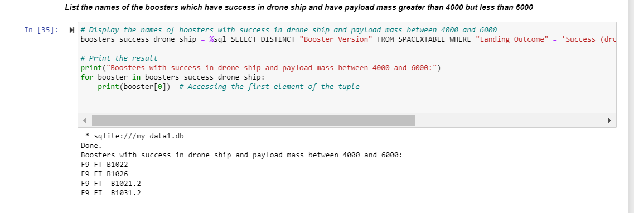
Successful Drone Ship Landing with Payload between 4000 and 6000
Code Explanation
boosters_success_drone_ship = %sql SELECT DISTINCT "Booster_Version" FROM SPACEXTABLE WHERE "Landing_Outcome" = ‘
Success (drone ship)' AND "Payload_Mass__kg_" > 4000 AND "Payload_Mass__kg_" < 6000;
boosters_success_drone_ship = %sql SELECT DISTINCT "Booster_Version" ...: Executes the SQL query and stores the result in boosters_success_drone_ship.
This result is a list of tuples with unique booster versions.
print("Boosters with success in drone ship and payload mass between 4000 and 6000:"): Prints a descriptive message.
for booster in boosters_success_drone_ship:: Iterates over the result list.
print(booster[0]): Prints the first (and only) element of each tuple, which contains the booster version.
Boosters with success in drone ship and payload mass between 4000 and 6000: F9 FT B1022 F9 FT B1026 F9 FT B1021.2 F9 FT B1031.2

Slide 30
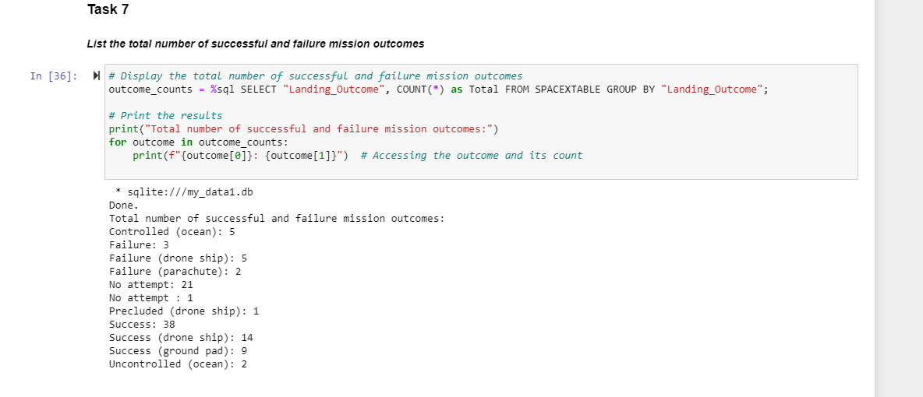
Total Number of Successful and Failure Mission Outcomes
Code Explanation
outcome_counts = %sql SELECT "Landing_Outcome", COUNT(*) as Total FROM SPACEXTABLE GROUP BY "Landing_Outcome";
# Print the results print("Total number of successful and failure mission outcomes:") for outcome in outcome_counts: print(f"{outcome[0]}: {outcome[1]}")
# Accessing the outcome and its count
outcome_counts = %sql SELECT "Landing_Outcome", COUNT(*) ...: Executes the SQL query and stores the result in outcome_counts.
This result is a list of tuples where each tuple contains a landing outcome and its count.
print("Total number of successful and failure mission outcomes:"): Prints a descriptive message.
for outcome in outcome_counts:: Iterates over the result list.
print(f"{outcome[0]}: {outcome[1]}"): Prints each landing outcome and its corresponding count.
The majority of missions have a successful outcome, with a significant number also landing on drone ships.
Failures are less common, with specific types like drone ship and parachute failures having notable counts.
There are several cases with "No attempt" and a few with specific controlled or uncontrolled outcomes.

Slide 31
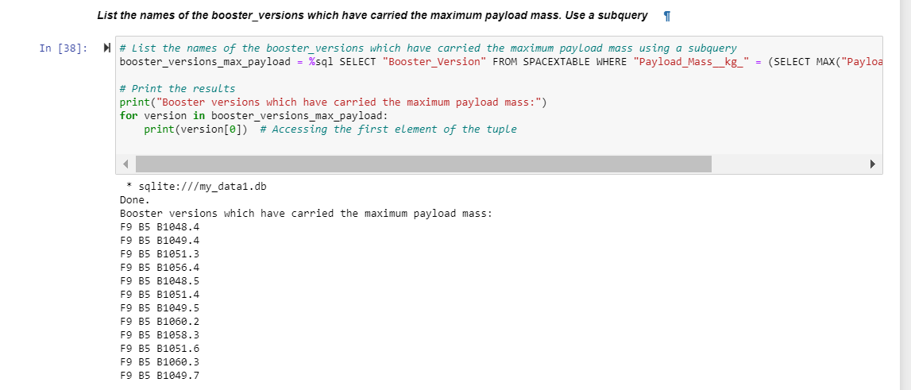
Boosters Carried Maximum Payload
Code Explanation
booster_versions_max_payload = %sql SELECT "Booster_Version" FROM SPACEXTABLE WHERE "Payload_Mass__kg_" = (SELECT MAX("Payload_Mass__kg_") FROM SPACEXTABLE);
# Print the results print("Booster versions which have carried the maximum payload mass:") for version in booster_versions_max_payload: print(version[0])
# Accessing the first element of the tuple
booster_versions_max_payload = %sql ...: Executes the SQL query and stores the result in booster_versions_max_payload. This result is a list of tuples containing the booster versions.
print("Booster versions which have carried the maximum payload mass:"): Prints a descriptive message.
for version in booster_versions_max_payload:: Iterates over the result list.
print(version[0]): Prints each booster version that carried the maximum payload mass.
Booster Versions: The result lists all the booster versions that have carried the maximum payload mass found in the dataset.
Maximum Payload Mass: Each of these booster versions achieved the highest payload capacity recorded, indicating their significant performance in carrying large payloads.
This query identifies the specific booster versions that have handled the highest payloads, highlighting their capacity and performance in missions.

Slide 32
2015 Launch Records
List the failed landing outcomes in drone ship, their booster versions, and launch site names for in year 2015
Present your query result with a short explanation here

Slide 33
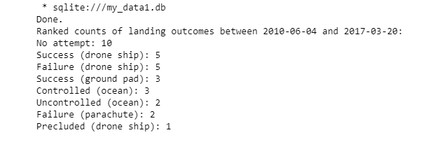
Rank Landing Outcomes Between 2010-06-04 and 2017-03-20
The most common outcome in the specified date range is "No attempt," with 10 occurrences. This suggests that there were many missions where no attempt was made to land.
Success (drone ship): 5: There were 5 successful landings on a drone ship, showing a notable achievement in this category.
Failure (drone ship): 5: There were 5 failures on a drone ship, indicating that landing on drone ships has had mixed results.
Success (ground pad): 3: Successes on ground pads occurred 3 times, demonstrating another successful landing method.
Controlled (ocean): 3: Landings controlled on the ocean were also recorded 3 times.
Uncontrolled (ocean): 2: There were 2 uncontrolled landings on the ocean, reflecting less successful attempts.
Failure (parachute): 2: Failures involving parachutes were recorded 2 times.
Precluded (drone ship): 1: The least common outcome, with only 1 instance where the landing was precluded on a drone ship.
This ranking helps in understanding the distribution of different landing outcomes over the specified period, highlighting both successful and unsuccessful attempts and the prevalence of each outcome type.

Slide 34

Section 3

Slide 35
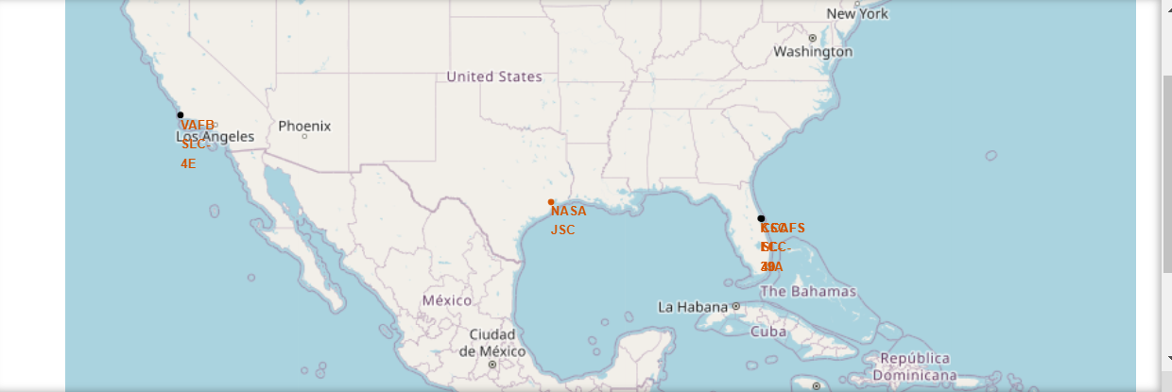
Folium Map all launch sites’ location markers
Launch sites are in proximity to the equator and the coast. This makes sense as it takes less fuel to get into space from the equator due to the physics of Earth's rotation. The launch sites in close proximity to the coast are also logical for safety reasons.

Slide 36
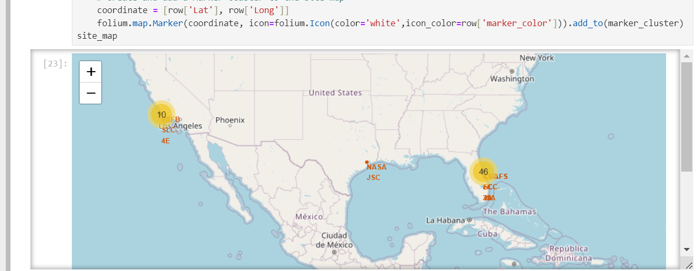
Folium Map all launch sites’ location markers with color labeled launch outcome
From the color-labeled markers in marker clusters, the launch sites have relatively high success rates.

Slide 37
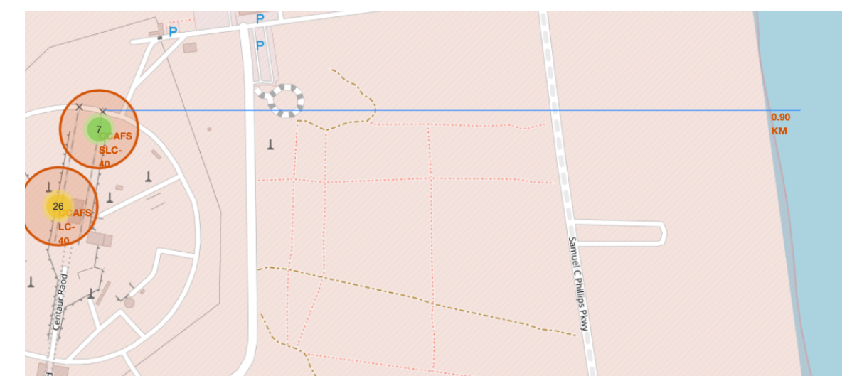
Folium Map Showing Distances Between A Launch Site To Its Proximities
Launch sites are in close proximity to equator to minimize fuel consumption by using Earth's ~ 30km/sec eastward spin to help spaceships get into orbit.
Launch sites are in close proximity to coastline so they can fly over the ocean during launch, for at least two safety reasons-- (1) crew has option to abort launch and attempt water landing (2) minimize people and property at risk from falling debris.
Launch sites are in close proximity to highways, which allows for easily transport required people and property.
Launch sites are in close proximity to railways, which allows transport for heavy cargo.
Launch sites are not in close proximity to cities, which minimizes danger to population dense areas.

Slide 38

Section 4

Slide 39
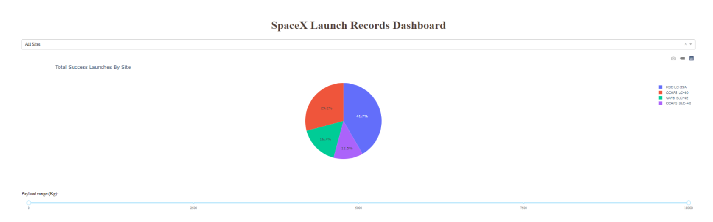
SpaceX Launch Records Dashboard- Total Launches By Site
This pie chart represents the distribution of launch success counts across different sites:
KLC LC-39A (41.7%): This site has the highest success rate, indicating it might be a preferred or more reliable launch site.
CCAFS LC-40 (29.2%): This site also has a significant number of successful launches, contributing to nearly a third of the total successes.
VAFB SLC-4E (16.7%): This site has a moderate success rate, representing less than a fifth of the total successful launches.
CCAFS SLC-40 (12.5%): This site has the lowest success rate among the four, accounting for about one-eighth of the successful launches.

Slide 40
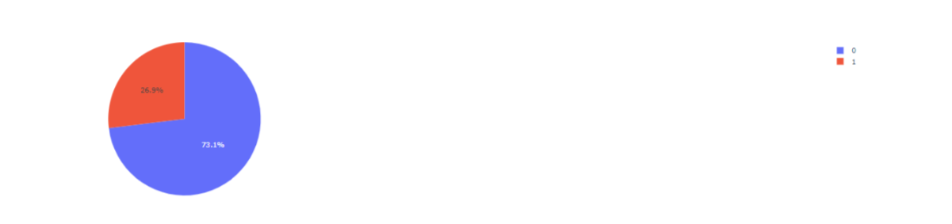
SpaceX Launch Records Dashboard- Launch site with highest launch success ratio

Slide 41
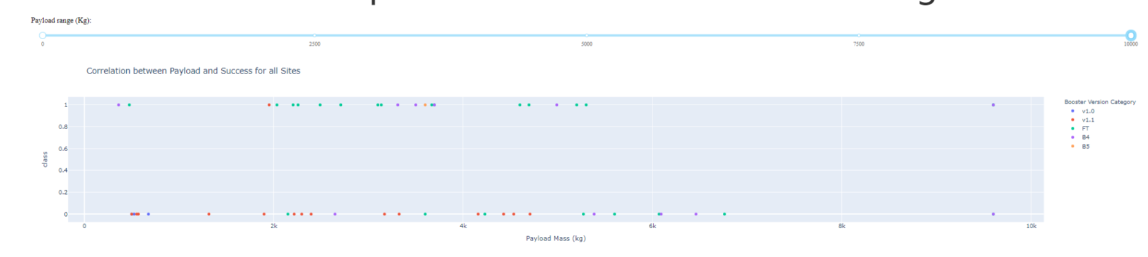
SpaceX Launch Records Dashboard- Payload vs. Launch Outcome

Slide 42

Section 5

Slide 43
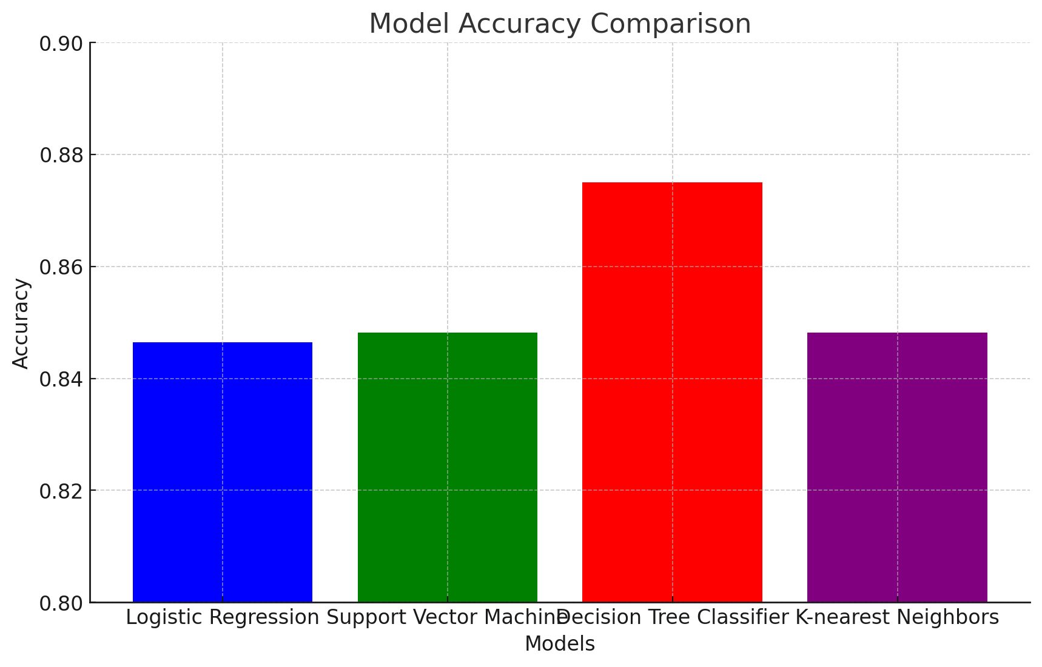
Classification Accuracy
Model Accuracy Comparison
Visualization
The bar chart displays the accuracy of each classification model.
Highest Classification Accuracy
The model with the highest classification accuracy is the Decision Tree Classifier with an accuracy of 0.875. ​

Slide 44

Confusion Matrix
The confusion matrix displays the performance of the Decision Tree Classifier in predicting the
success of the Falcon 9 first stage landings.
The confusion matrix provides a summary of the prediction results:
True Negative (TN): 3 instances where the model correctly predicted a landing failure.
False Positive (FP): 12 instances where the model incorrectly predicted a successful landing.
False Negative (FN): 3 instances where the model incorrectly predicted a landing failure.
True Positive (TP): 12 instances where the model correctly predicted a successful landing.
These results help in understanding the accuracy and error distribution of the Decision Tree Classifier,
which has been identified as the best-performing model in this analysis. ​

Slide 45
Conclusions
Model Performance:
The Decision Tree Classifier emerged as the best-performing model with an accuracy of 87.5%, indicating it was the most effective in predicting the success of Falcon 9 first stage landings among the models tested.
Confusion Matrix Insights:
The confusion matrix for the Decision Tree Classifier revealed that while the model has a good overall performance, there are still notable instances of misclassification:
False Positives (FP): 12 cases where the model incorrectly predicted a successful landing.
False Negatives (FN): 3 cases where the model incorrectly predicted a landing failure.
The balance between True Positives (TP) and True Negatives (TN) is crucial for understanding the model's strengths and weaknesses.
Data Preprocessing and Feature Engineering:
Effective preprocessing and feature selection were critical in building robust models. Standardizing data and carefully selecting features (e.g., Payload Mass, Orbit type, etc.) contributed to the model's performance.
Hyperparameter Tuning:
Grid Search was essential in optimizing the hyperparameters for each model, which helped in achieving the best possible accuracy for the given dataset.
Predictive Analysis:
The project demonstrated the potential of machine learning in predictive analysis for space missions. Predicting the success of rocket landings can aid in planning and resource allocation for future missions.

Slide 46
Appendix
Include any relevant assets like Python code snippets, SQL queries, charts, Notebook outputs, or data sets that you may have created during this project

Slide 47


